Slide 1

Detecting AI Generated Images using Deep Learning
Group 32
Aaron Teo Rui Kang (A0155714E)
Jason Ciu Putra Sung (A0219734Y)
Kok Yi Ling (A0203933L)
Putri Darmawan (A0200717R)
Wilson Kurniawan (A0093874N)

Slide 2
Introduction
Kok Yi Ling (A0203933L)

Slide 3
Project Overview
Motivation & Problem Statement:
In the recent years, the rise of generative AI has led to remarkable advancement in creating realistic images and videos. Deepfakes and other AI-crafted media threaten trust in online content, enabling misinformation, fraud, and reputational harm.
Goal:
Perform data analysis to explore differences AI-generated images and real images, and train discriminative models that can differentiate them.

Slide 4
Methodology
Dataset Collection & Preparation:
Kaggle’s 2025 Women in AI Kaggle Challenge (Real Images from Shutterstock and AI generated images from DeepMedia)
Test set generated by our own Generative models:
Variational AutoEncoder (VAE)
Generative Adversarial Networks (GAN)
Diffusion models
Models:
Baseline CNN
Resnet
CBAM Resnet

Slide 5
EDA
Putri Darmawan (A0200717R)

Slide 6
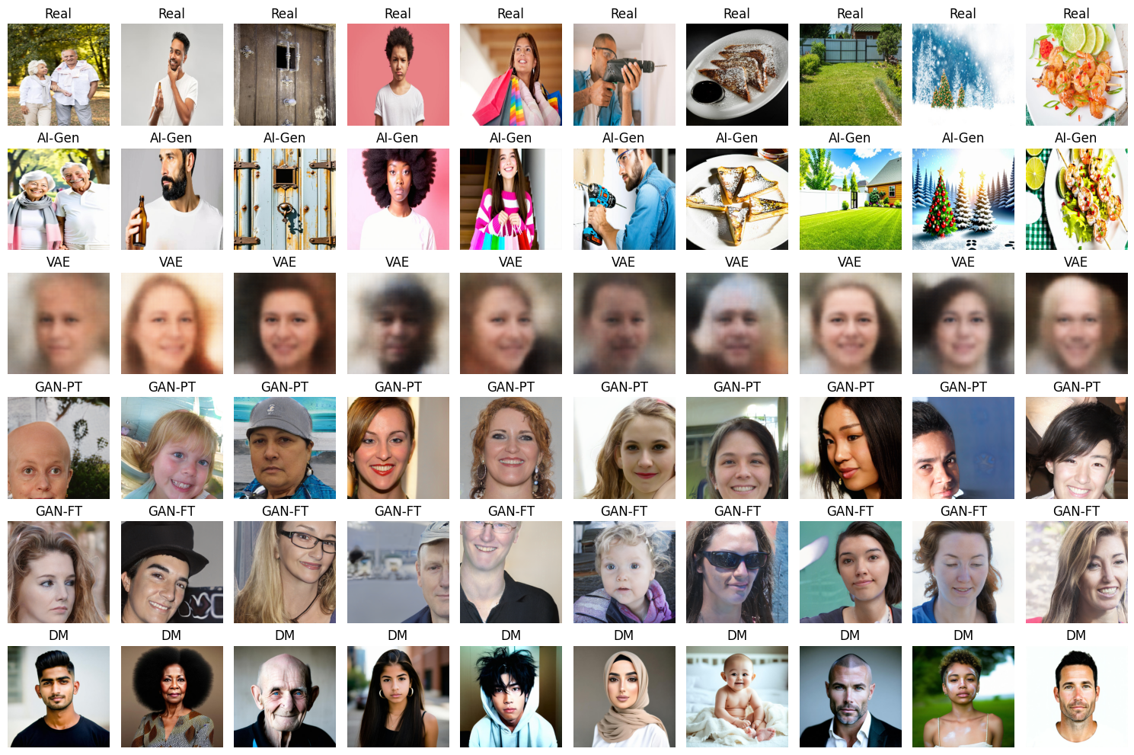
EDA
Class Distribution in Dataset:
Real images: 39975
AI-Gen: 39975

Slide 7
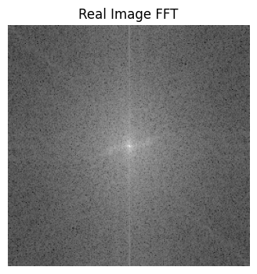
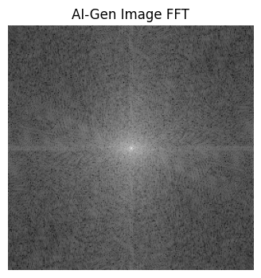
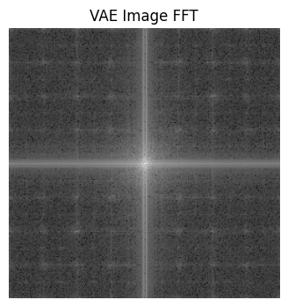
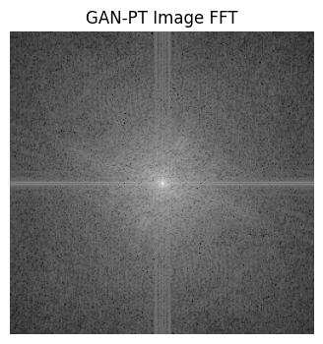
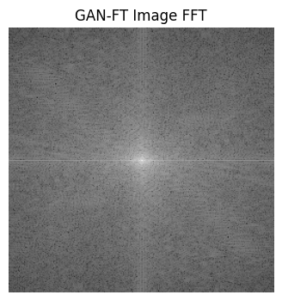
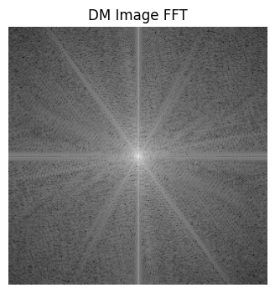
FFT
FFT converts an image from pixels to how much of the image is made up of patterns of various sizes. It helps us see repetitions, textures, and fine details in terms of frequency components.

Slide 8
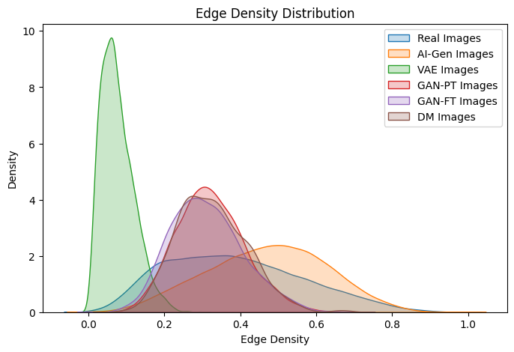
Distribution Analysis
AI-generated images has more uniform distribution compared to real images in term of edge density. This means that most of generated images have a similar level of edge detail, which indicates a lack of variability in the textures and structures
Very different distribution between the generated images and real images

Slide 9
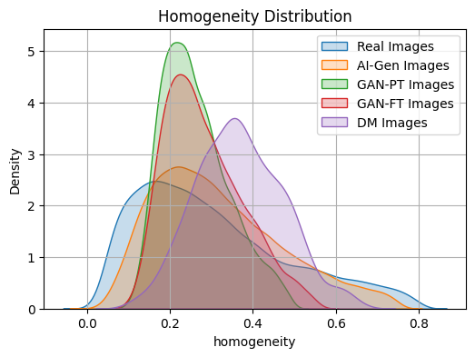
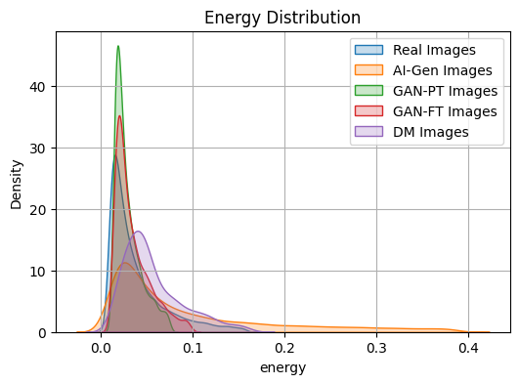
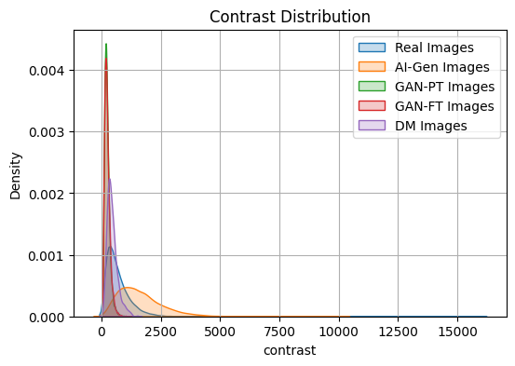
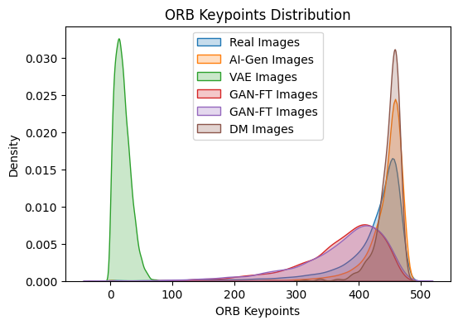
Different distribution between the generated images and real images
Generated images have:
Very narrow distribution for contrast -> lack of variation
Higher (peak is more on the right) and narrower distribution for homogeneity -> smoother and lack of variation
Higher and narrower distribution for energy -> more repetitive or simple the texture is
Low ORB keypoints -> smoother and simpler pixels

Slide 10
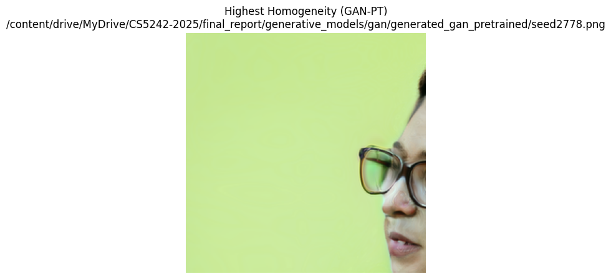
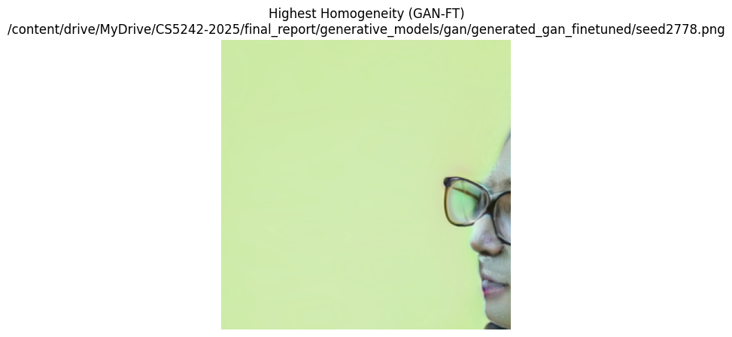
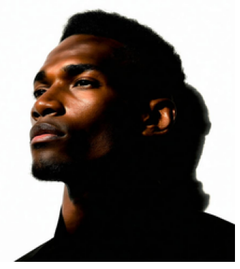
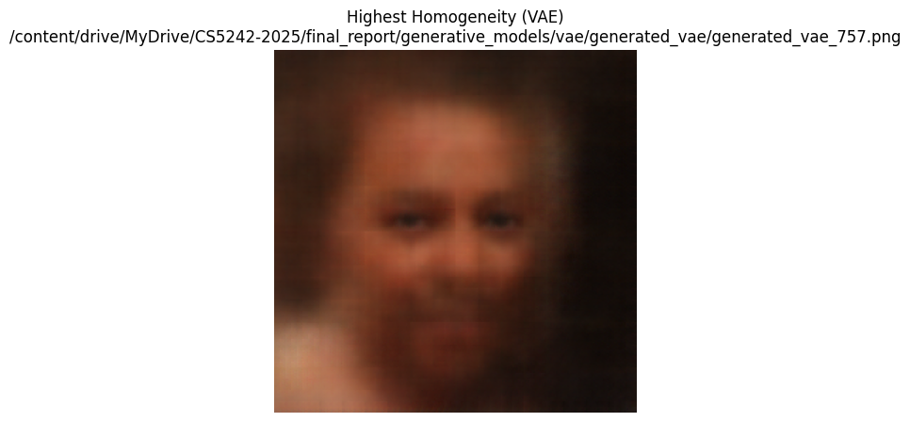
Sample of “weird” generated images
VAE
GAN-PT
GAN-FT
DM

Slide 11
Data Preprocessing
Putri Darmawan (A0200717R)

Slide 12
Data preprocessing
Resizing of the image to 128x128, so that all images have the same size.
Data augmentation
Random image rotation and colour jitters (brightness=0.2, contrast=0.2, saturation=0.2, hue=0.1)

Slide 13
Model Development
Aaron Teo Rui Kang (A0155714E)

Slide 14
Model Development
Models
Two-layer Vanilla CNN
ResNet-18
CBAM ResNet
Batch size = 128
Number of epochs = 10
Learning rate = 0.001
Optimiser = AdamW
Loss = Cross Entropy Loss

Slide 15
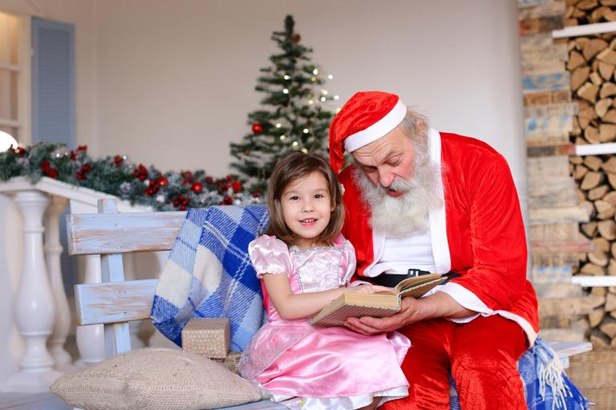
Model Development - Vanilla CNN
re
Real
Fully Connected Layer + ReLu
Dropout Layer
Channels = 3
3x3 kernels
Channels = 16
ReLu
BatchNorm
Maxpool(2, 2, stride=2)
3x3 kernels
Channels = 32
ReLu
BatchNorm
Maxpool(2, 2, stride=2)
Fake

Slide 16
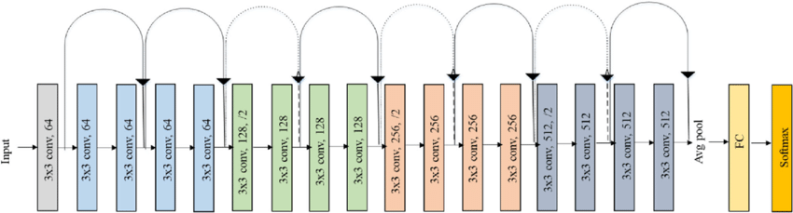
Model Development - ResNet18
Common CNN architecture for image classification

Slide 17
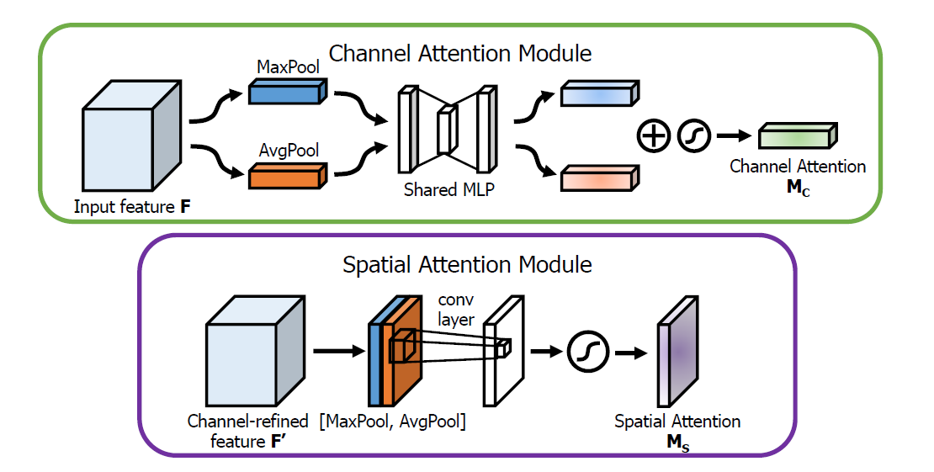
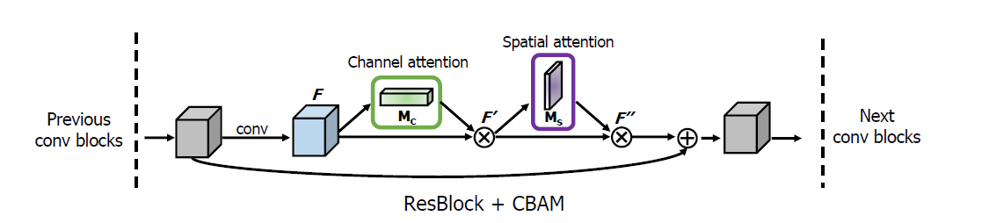
Model Development - CBAM ResNet
Extension of ResNet to include attention mechanism

Slide 18
Results
Model | Train F1 score | Validation F1 score | Test F1 score
Two-layer Vanilla CNN | 0.9641 | 0.9749 | 0.9755
ResNet18 | 0.9518 | 0.9806 | 0.9814
CBAM ResNet18 | 0.9613 | 0.9783 | 0.9814

Slide 19
Generative Models
Jason Ciu Putra Sung (A0219734Y)

Slide 20
Generative Models
To enrich our dataset, we created our own images
Models:
VAE
GAN
Diffusion Model
Goal: To test generalization and robustness to distributional shift
To maintain consistency, we focus on face-related images

Slide 21
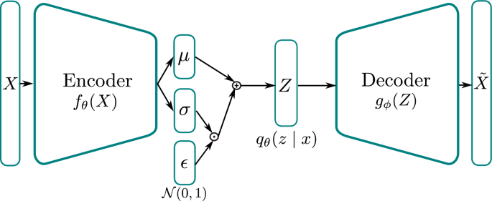
Variational Auto Encoders
Trained from scratch on FFHQ (face) dataset.

Slide 22
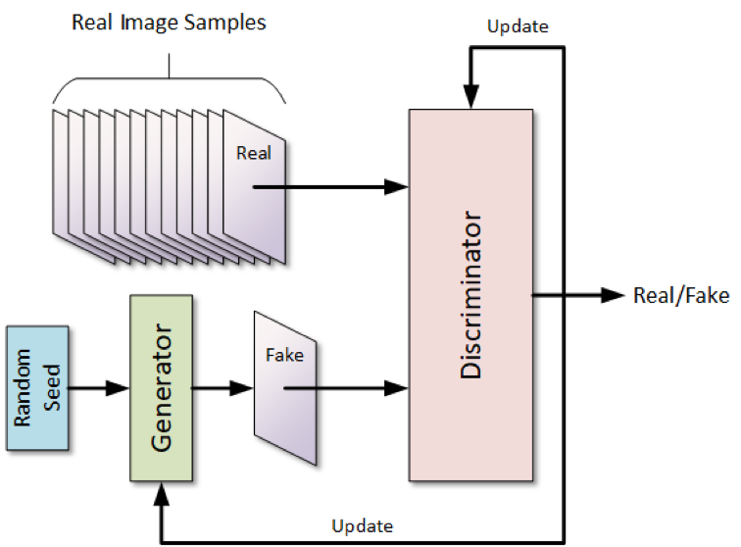
GAN
Use the StyleGAN3 pretrained on FFHQ
Another one that is further fine-tuned on our own training dataset

Slide 23
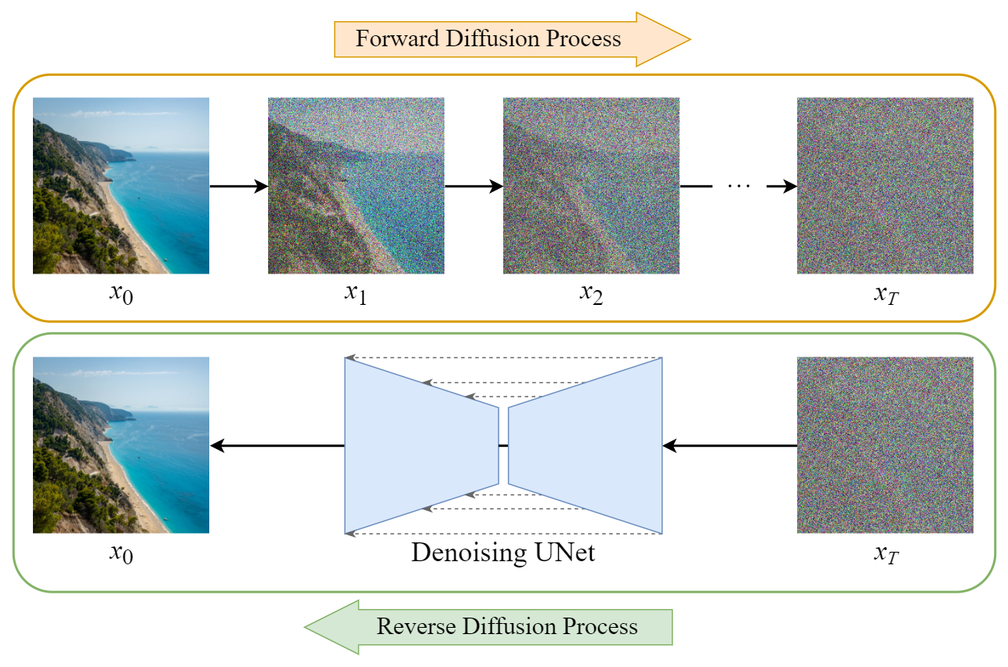
Diffusion Model
Directly do generation on the StableDiffusion Large 3.5 API

Slide 24
Evaluation on Self-Generated Images
Extremely poor performance in the unseen and out-of-domain test set
Model | VAE F1 score | GAN-PT F1 score | GAN-FT F1 score | DM F1 score
Two-layer Vanilla CNN | 0 | 0.008 | 0.004 | 0.4
ResNet18 | 0 | 0.0354 | 0.0198 | 0.4561
CBAM ResNet18 | 0 | 0.008 | 0.004 | 0.4286

Slide 25
Fine-tuning the Models
Wilson Kurniawan (A0093874N)

Slide 26
Dealing with out-of-domain images
Since the baseline trained models are rather domain-specific, we attempted the following improvements:
Fine-tuning the models by freezing the feature extractor and retraining only the classification head.
Re-training the models with our generated images included in the training and validation datasets.

Slide 27
Evaluation Result
Fine-tuning allows the models to detect other kinds of generated images, at the expense of worse score in predicting images from Kaggle dataset.
The performance for DM-based images is very good => domain adaptation works for this type of image.
Model | Kaggle F1 score | VAE F1 score | GAN-PT F1 score | GAN-FT F1 score | DM F1 score
Two-layer Vanilla CNN | 0.8565 | 0.0198 | 0.3193 | 0.2301 | 0.8421
ResNet18 | 0.5744 | 0.2425 | 0.7685 | 0.6505 | 0.9885
CBAM ResNet18 | 0.4577 | 0.1718 | 0.8067 | 0.7326 | 0.9885

Slide 28
Evaluation Result
Re-training allows the models to have a generally high score across all test images.
The performance for images from Kaggle dataset is still worse than the original baseline models, but far better than the fine-tuned models.
Model | Kaggle F1 score | VAE F1 score | GAN-PT F1 score | GAN-FT F1 score | DM F1 score
Two-layer Vanilla CNN | Not done due to resource limitation
ResNet18 | 0.9681 | 0.9970 | 0.9733 | 0.9659 | 0.6667
CBAM ResNet18 | 0.9274 | 1.0000 | 0.9930 | 0.9868 | 0.7429

Slide 29
Limitations + Future Work
Wilson Kurniawan (A0093874N)

Slide 30
Limitations
Resource Constraints: Due to high resource requirement (RAM and GPU), model training can only be conducted sparingly. Improvements from small-scale experiments don’t always carry over to full-dataset training.
Limited Real Image Data: While we augment the dataset with self-generated AI images, we didn’t source for additional real images. We could not confidently verify that the model would generalize well to real-world images beyond the provided Kaggle dataset.
Domain Generalization: Our attempt in domain adaptation is met with limited success and may not work as well when encountering entirely new, unseen domains. Future research could explore domain generalization techniques to further improve the model’s robustness across novel domains.

Slide 31
End of Presentation

